Slide 1

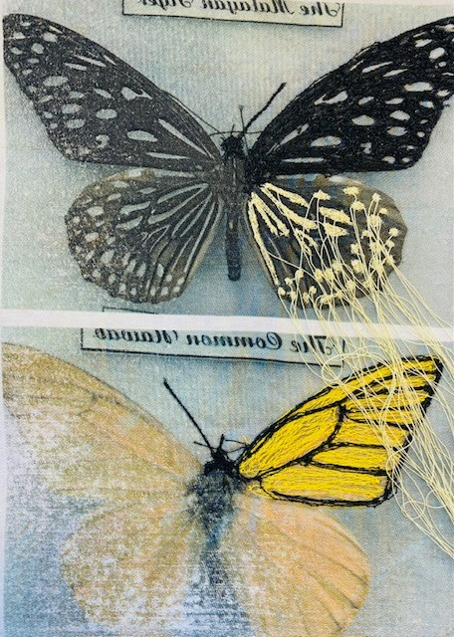
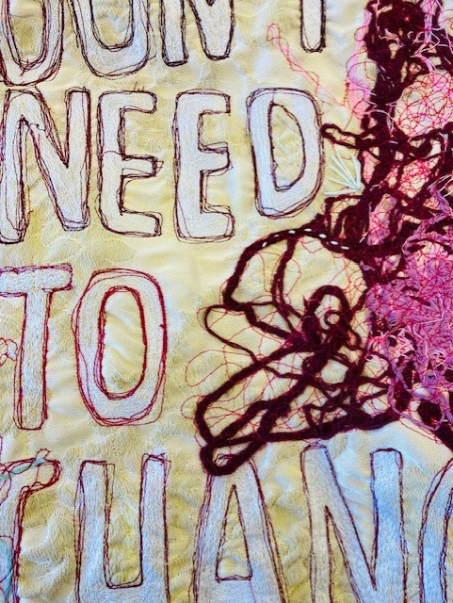
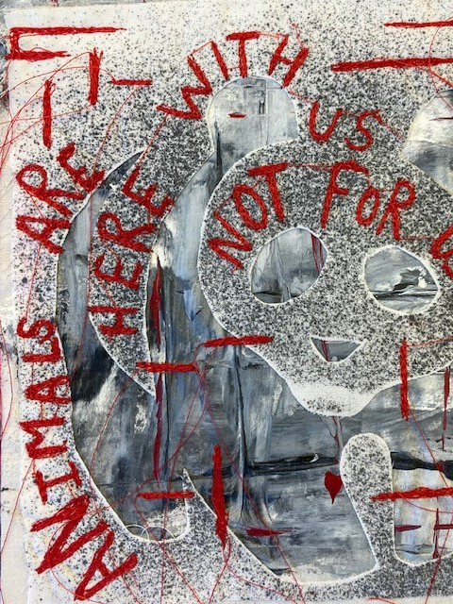
GCSE
Textiles

Slide 2
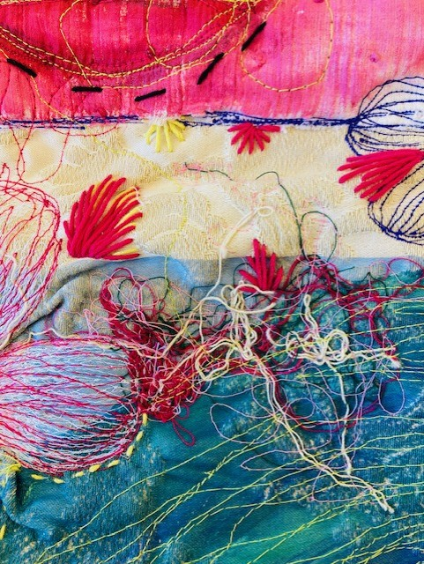
What kind of student is this course suitable for?
For the intellectually curious, creative and practically inclined students and those who are interested in exploring their imagination and experimenting with ideas through visual means and a broad range of textile media, Machine and hand embroidery, Weaving, Applique, Fabric printing, Felting, Mixed media surface decoration, Dyeing, Installation, Printing, Painting, Fabric sculpture
Great value is placed on independent thought and the refinement of skills. Coursework is contained within lessons and prep times and backed up in holidays to gather sufficient resources/ firsthand imagery.

Slide 3
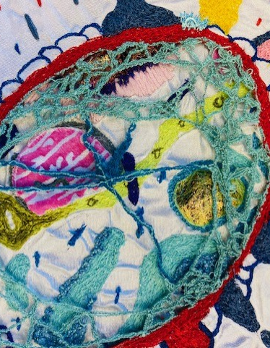
What do I need to know or be able to do before taking this course?
Art textiles is defined here as the practice of creating work that is primarily for aesthetic, intellectual or purely conceptual purposes, rather than purposes that have a necessarily practical function.
Students will explore, acquire and develop skills, knowledge and understanding through the application of techniques and processes.
Students will explore practical, relevant, critical and contextual sources exploring work of historical and contemporary textiles artists, designers, artists, gaining understanding, processes, purposes, intentions and functions of their and the relationship to their own work.
Students will demonstrate the knowledge, skills and understanding through area(s) of study relevant to art textiles exploring one or more of the following: Machine and hand embroidery, Weaving, Applique, Fabric printing, Felting, Mixed media surface decoration, Dyeing, Installation, Printing, Painting, Sculpture

Slide 4
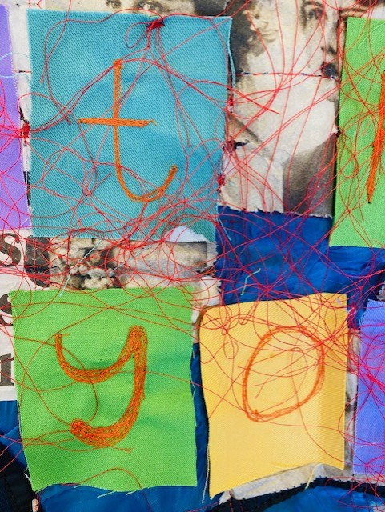
What will I learn on the course?
Developing essential creative, imaginative and problem-solving skills
Visually communicating and expressing ideas, feelings and meanings
Investigative, analytical, experimental and interpretative skills
Understanding and the context of textiles art in different cultures
Improving practical skills, using a variety of textiles materials and media

Slide 5
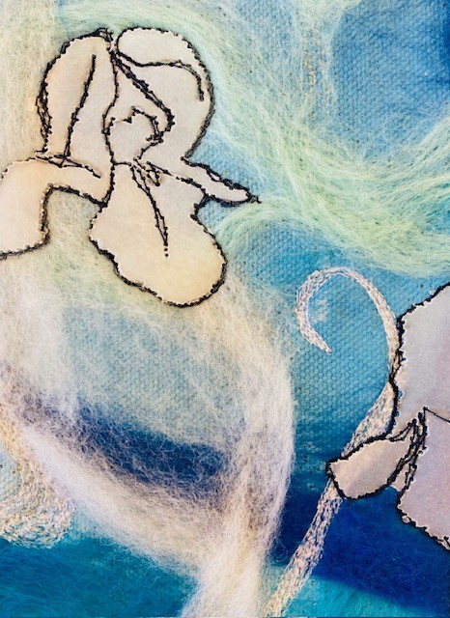
Course Structure
The OCR GCSE Textiles course is structured into two components:
Component 1: Portfolio (60%)
  This is a portfolio of work produced to a center- or learner-set starting point leading to final artefact(s)/ product(s)/personal outcome(s).
  This portfolio will consist of a project, theme or course of study. It may be presented in appropriate format(s) for the specification title and area(s) of study chosen. For example, sketchbooks, digital presentations, mounted sheets, maquettes, prototypes, animated work, scale models or illustrated written work.
  Component 2: Externally Set Assignment (40%)
  For this component, an early release paper will be dispatched to centers
  The paper will give learners a choice of five themes, each with a choice of written and/or visual starting points or stimuli. From this paper, learners are expected to choose one option for which they will generate an appropriate personal response of one or more artefact(s)/product(s)/personal outcome(s) within a 10-hour supervised time period. The paper will also give the learner an opportunity to develop an extended response. Please see Section 3e for further details

Slide 6
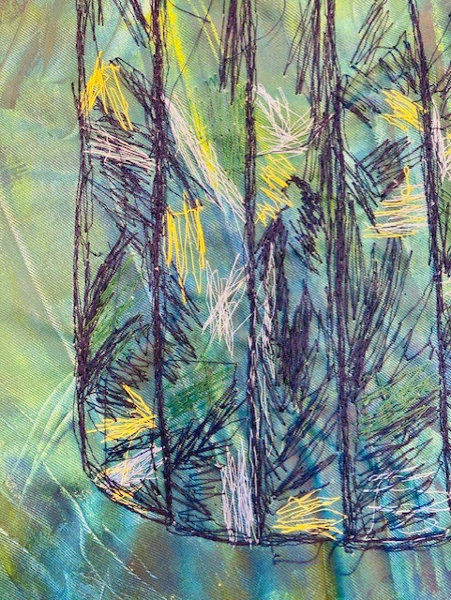
Component 1
Portfolio
The core of Component 1 is a portfolio showcasing the development of your textile work. This involves a creative process where you investigate your chosen theme and develop design ideas through a variety of methods.
Component 1
Learners must show they have:
• developed ideas through investigations and demonstrated critical understanding of sources from a given starting point
• produced material informed by context that is relevant to the development of their ideas
• refined work by exploring ideas, selecting and experimenting with media appropriate to their chosen specification title and area(s) of study
• recorded ideas, observations and insights relevant to intentions as work progresses
• presented a personal and meaningful response that realises intentions.

Slide 7
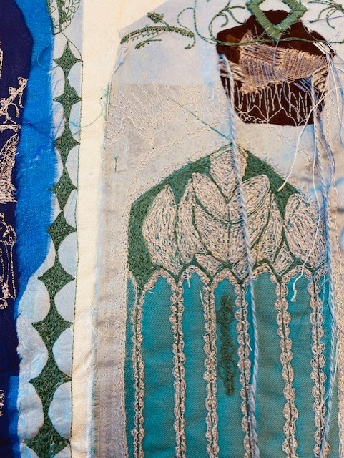
Component 2
Component 2 of the OCR GCSE Textile Design course is the Externally Set Assignment (ESA), which makes up 40% of your total marks.
Externally Set Task is 12 weeks preparation then 10hrs exam (2 days) It is a practical project where you respond to a given starting point set by OCR, culminating in a final piece produced during a timed exam.
Externally Set Assignment (ESA) Paper
The assignment begins with the release of the ESA paper. This paper contains a selection of starting points, themes, or prompts for you to choose from.
Themes/Starting Points: The paper typically includes eight different starting points, which can be interpreted in a variety of ways depending on your interests and strengths.

Slide 8
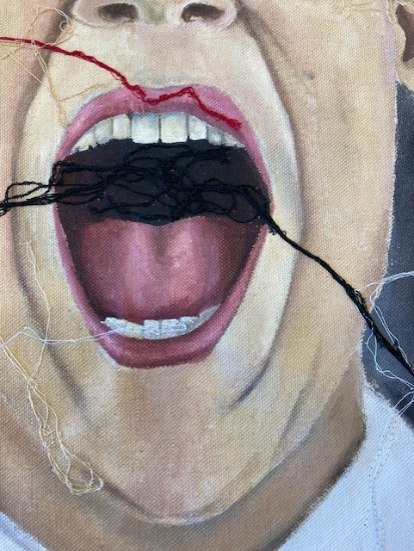
Next steps
Taking Textile GCSE Design can open the door to a variety of next steps in education, particularly in the fields of fashion, design, and art. The skills and knowledge developed during the course are highly valuable for creative disciplines that involve textiles, fabrics, and material manipulation. Here are some areas that GCSE Textile Design can lead to:
Fashion Design
Textile Design
Fashion and Textile Marketing
Costume Design
Interior Design
Textile Technology
Surface Pattern Design
Fashion Promotion/Communication
Textile Art and Mixed Media
Product Design
Sustainable Fashion and Textiles
Fashion Buying and Merchandising which could include:
Fashion Management
Creative Direction for Fashion
Design for Performance
Art and Design Foundation

