Slide 1
OCR GCSE Food Preparation and Nutrition
An Introduction

Slide 2
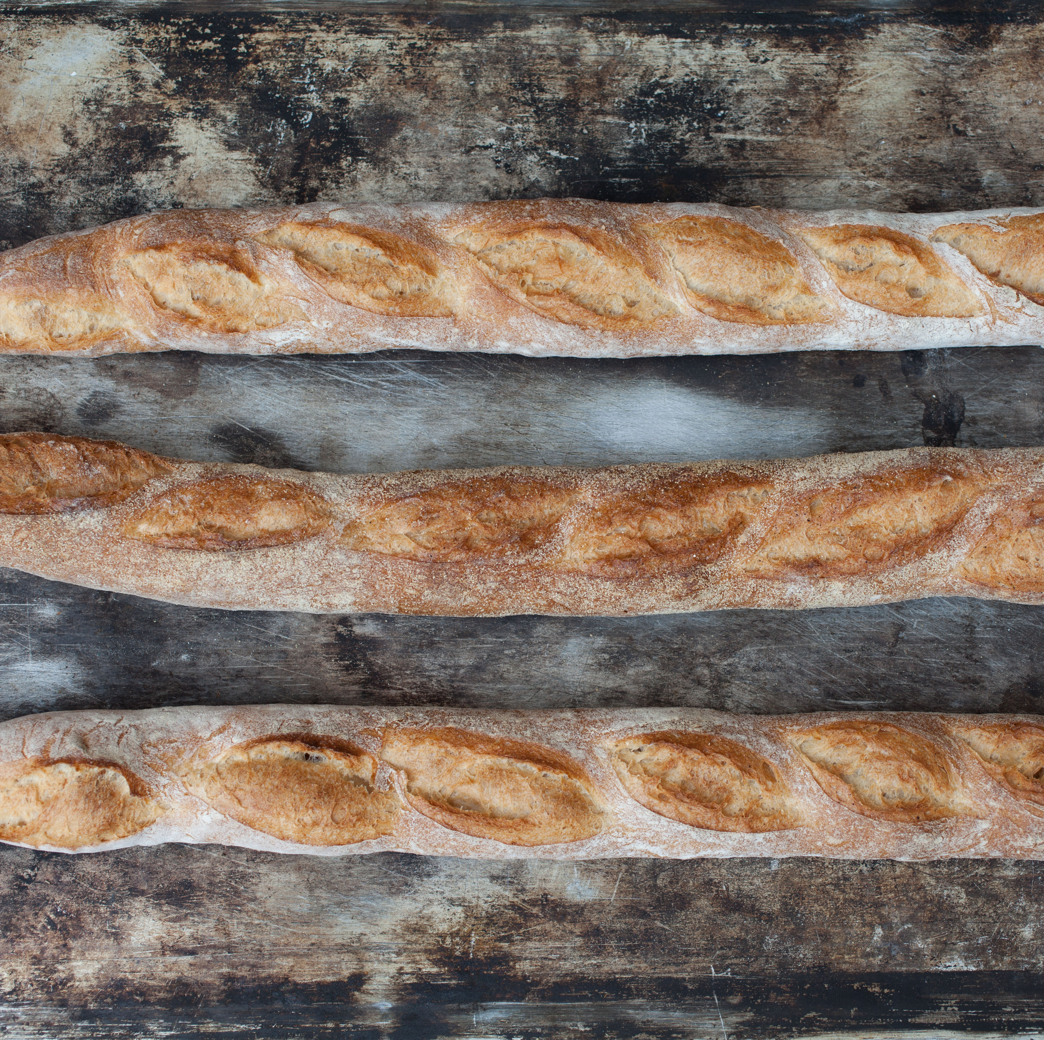
food in education
Practical skills in food preparation
Understanding nutrition and health
Food science
Food safety
Environmental issues and sustainability

Slide 3
Breakdown of the course
50% theory exam
15% NEA1 food science assessed coursework with a portfolio
35% NEA2 Practical assessed work with a portfolio
There will be lots of cooking and improving of cooking skills
It isn’t, cooking every week!

Slide 4
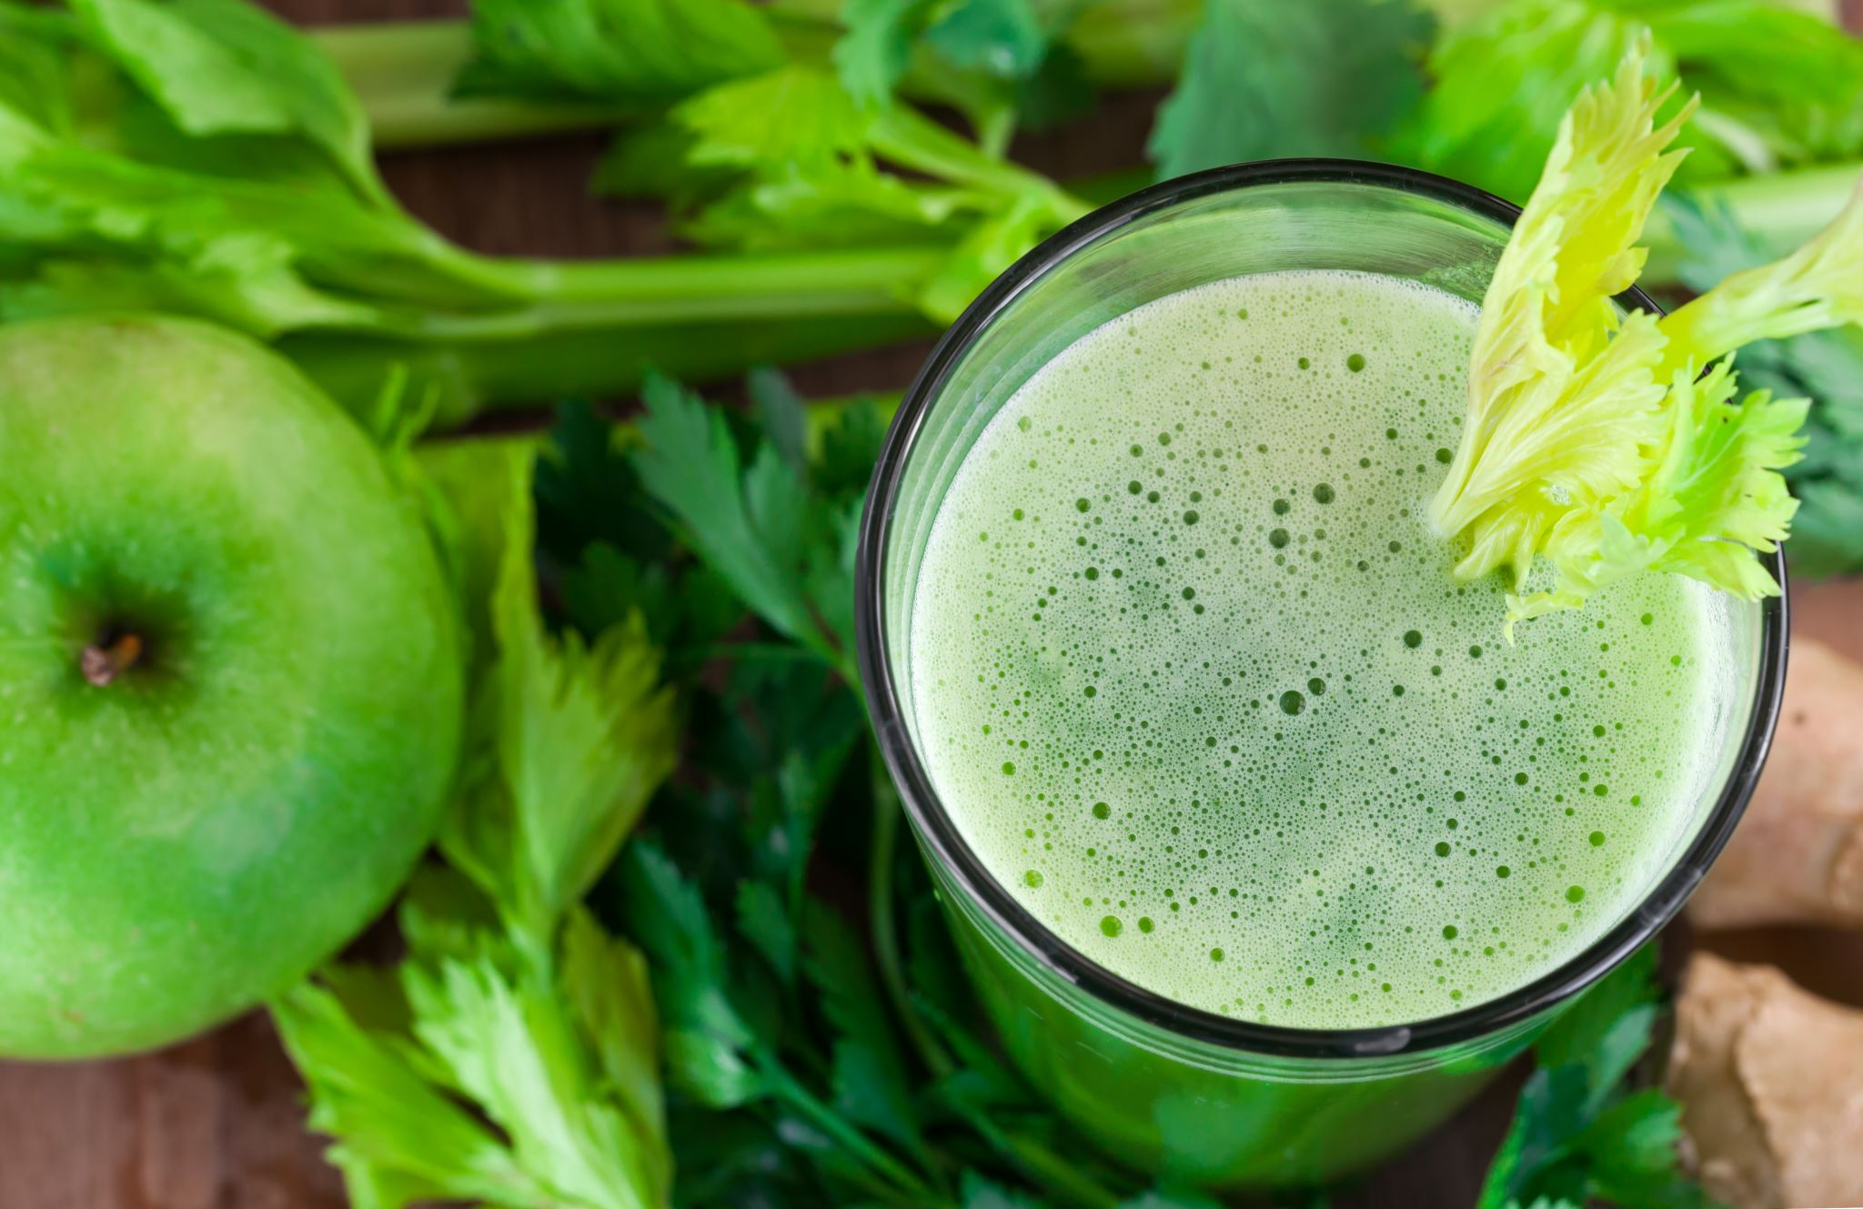
Timing
Approximately 50% of the course will be learning from doing
The other half will be theory based.
This is often happening at the same time and an organised methodical approach to every lesson is vital.

Slide 5
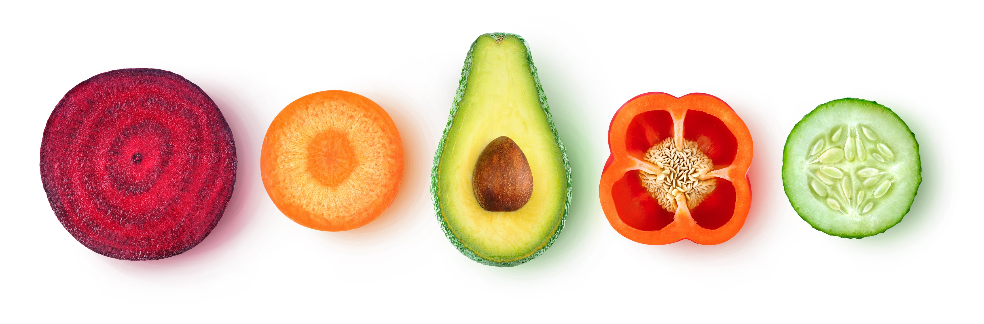
Nutrition
Everything that is made and created will involve understanding what it offers nutritionally.
Senses will challenged and understood
Whilst not losing slight of the pleasure of food.

Slide 6
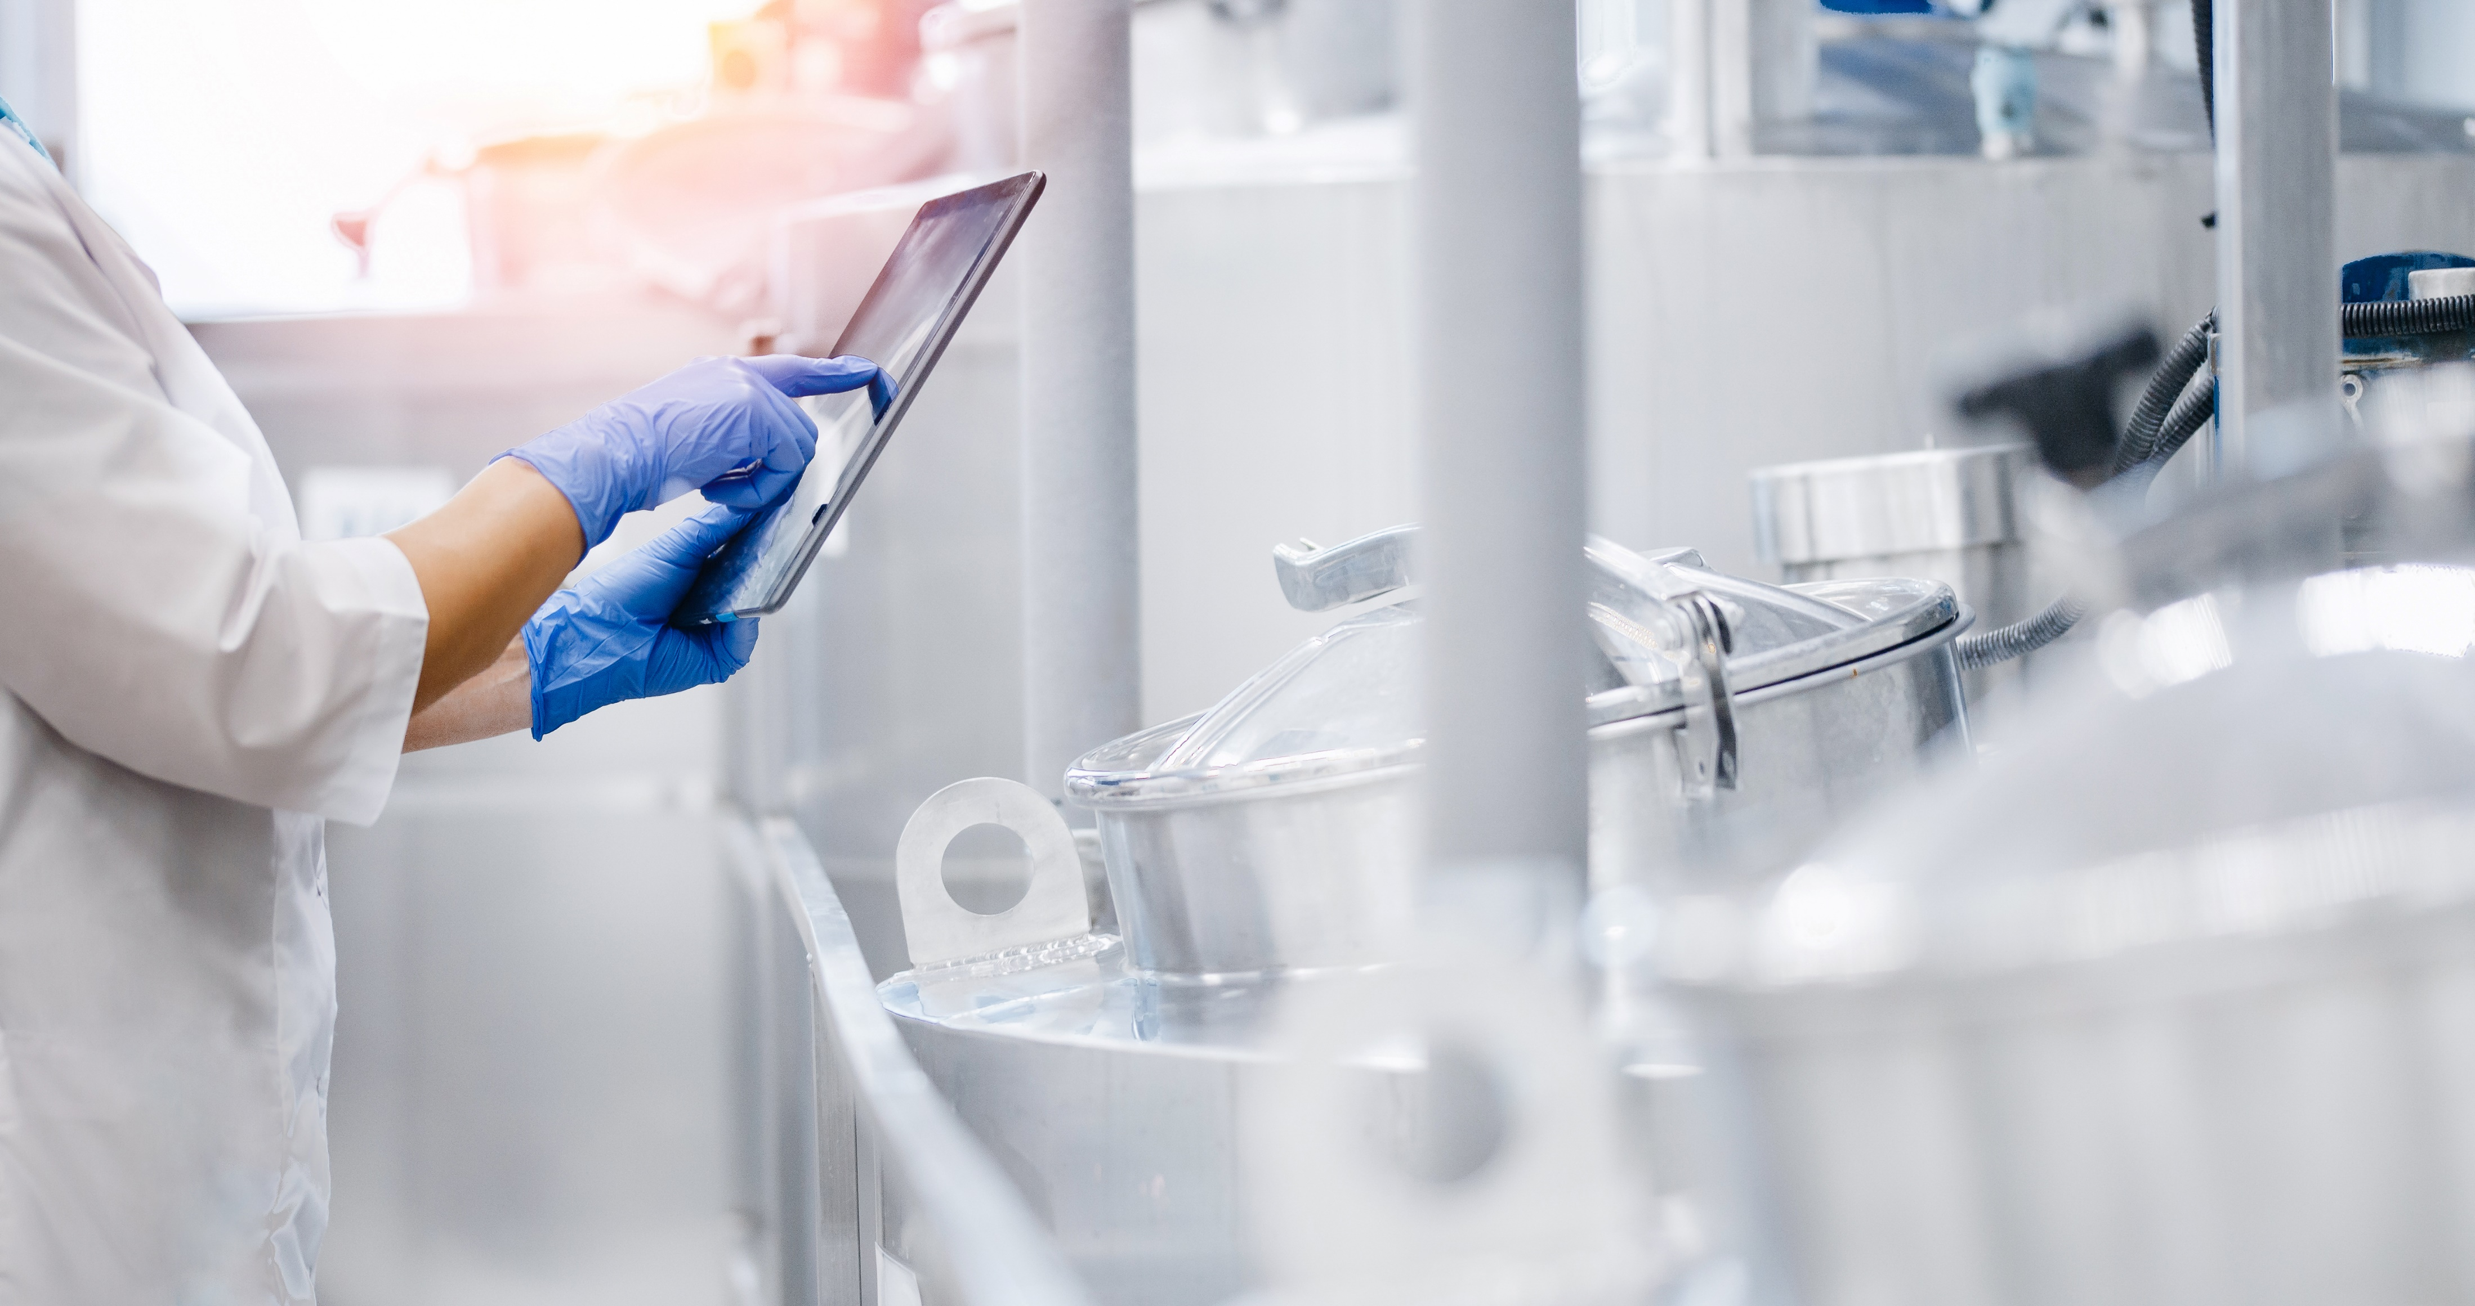
Science
The understanding of what is happening when we work with food and why that happens

Slide 7
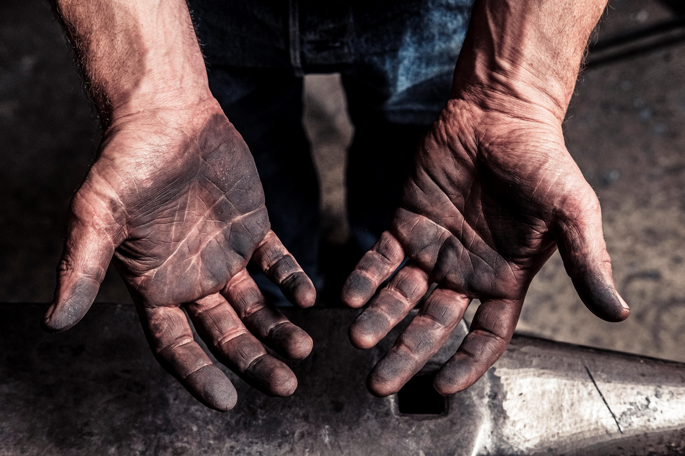
Food Safety
Working safely with food
The dangers of bad habits
The pleasure of working tidy!!!!!!!

Slide 8
Outcome of the course
Your child will be more independent!
They will be able to feed themselves when they leave home!
Increased confidence from learning a new set of skills
And…..
Gain a GCSE at the same time!

Slide 9
Questions?

