Slide 1
Drama
GCSE

Slide 2
The Drama Team
Mr J Hornsby
Ms S Single
Miss H O'Donnell, Director in Residence
Mrs Sally Britten-Snell, Wardrobe Mistress

Slide 3
Why choose this subject?
A kinaesthetic approach to academia which centres around practical application of knowledge through exploration of literature and cultural context.
To develop confidence, self-expression, creative thinking, analytical skills, and teamwork.
Transferrable skills applicable to a wide range of higher education subjects and in the workplace.
Workshops, seminars, trips, public performances and opportunities to work with professional directors, actors and theatre companies.

Slide 4
The nature of the course
Examination board: EDUQAS
Course contents:
Component | Outline | Assessment
Component 1 120 marks – 40% | Devising Theatre Non-examined Assessment | Devised piece using techniques of an influential practitioner (30 marks) Process portfolio (999 words) (60 marks) Evaluation of performance (exam conditions 1 hour and 30 minutes) (30 marks)
Component 2 60 marks – 20% | Performing from a Text Externally assessed by visiting examiner | Performance of two extracts from the same play
Component 3 120 marks – 40% | Interpreting Theatre Written Examination | Written exam 1hr 30 mins Section A – Set text – refugee Boy (90 marks) Section B – Live Theatre (30 marks)

Slide 5
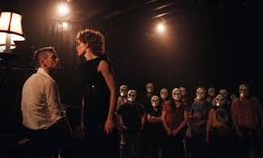
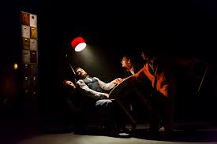
Examination structure
Fourth Form: C1 performances completed by Easter C1 Portfolio and Evaluation Completed by Summer
Fifth Form: C2 performances completed by February
C3 in May with content learnt throughout two years

Slide 7
Higher Education and Careers?
Students offered places at Drama School and studying Theatre at university.
Evidence that Theatre Studies facilitates acceptance to Law at Russell Group universities.
Universities and employers recognise the transferrable skills developed.

